Slide 1
Team S2 SP4
Jason, Darren, Marcus

Slide 2
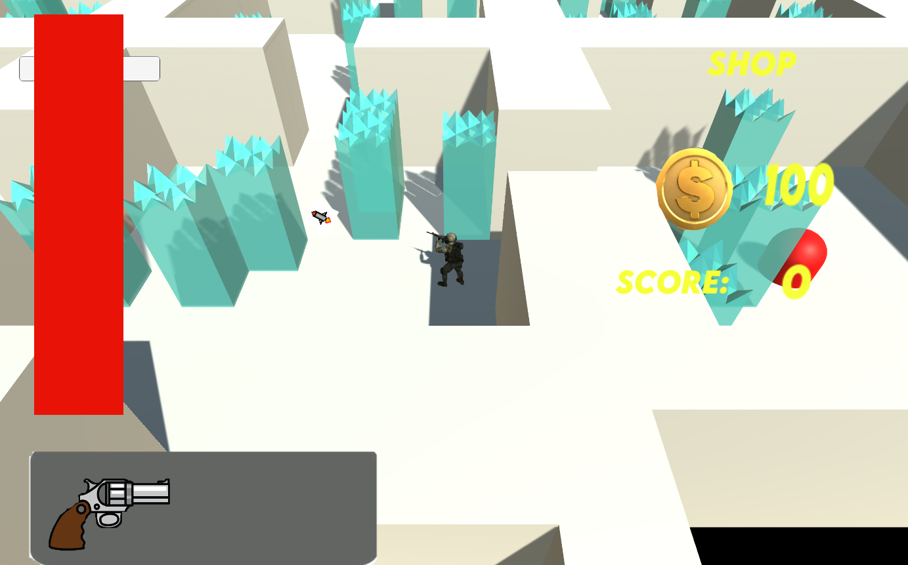
Clockwork Delvers
Battle Smart Battle Together
Clockwork Delvers will be a dungeon crawling type of game where players will have to defeat enemies with the help of their friends in order to progress through the game.
The game is over if all players die
The game is won when the exit is found

Slide 3
Task Breakdown
Working Multiplayer
Grid based map generation(Puzzles)
Loot drops on killed location(extra hp,money)(mini magnet effect when near)
2 weapon slots(Inventory)
Shop(for weapons + Revival item)
AI(Enemies)
Breakable OBJs(bushes, stones etc)
Collision
Player Specifics(Free movement, attack etc.)
Animation
Start, Connection(Waiting for players), Main menu, Pause, End screens

Slide 4
Task Allocation
Marcus | Loot drops AI Framework
Jason | Grid based map generation Player Specifics Collision
Darren | UI Start, Main menu, Pause Weapons

Slide 5
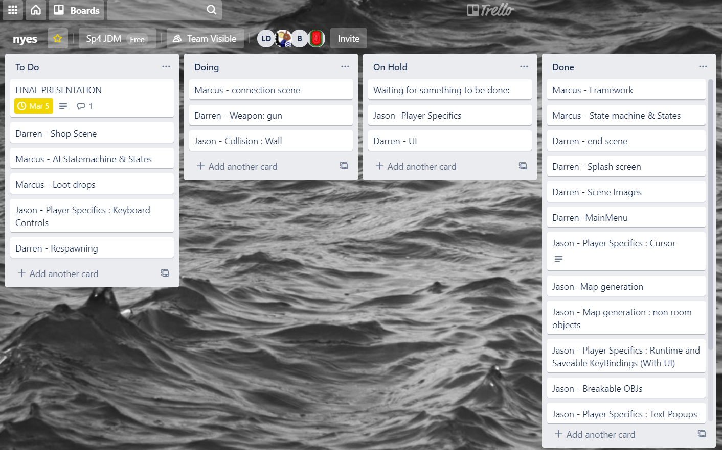
Trello

Slide 6
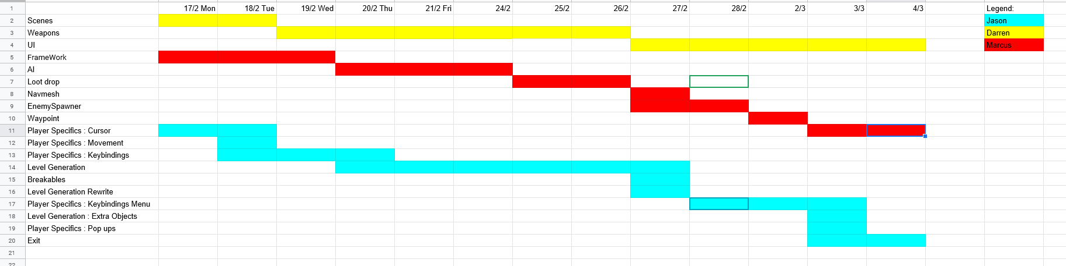
Project Schedule
gantt chart

Slide 7
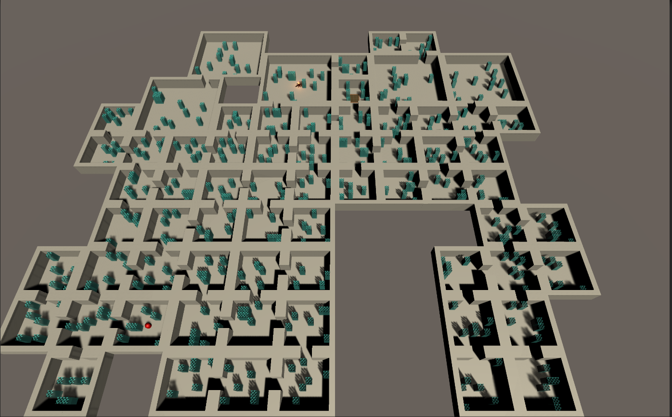
Jason - Level Generation
Features
All Generated rooms will connect to each other
Rooms can have objects that also randomly spawn inside
How It Works
Generates a starting point at the center of a given grid size
Creates a list of every room an exit/doorway can connect to and randomly chooses one
This goes on until all exits are exhausted
Once Completed, a spawn point and exitpoint are created on a random room
Then the rooms are populated with small objects that are destructible. (Later Added on)
Knowledge applied
Loosely based off AI’s pathfinding algorithm and maze generation
General Idea is based off dungeon maker 2 (Based on for the Rewrite)
Problems
Original version had a more random way to choose a room and was very messy
It was difficult to get 2x2 rooms on the grid to rotate properly without messing up the whole system
Future Improvements
Generate a grid for the small objects and exit points and such to prevent those from clipping
Add more small objects.

Slide 8
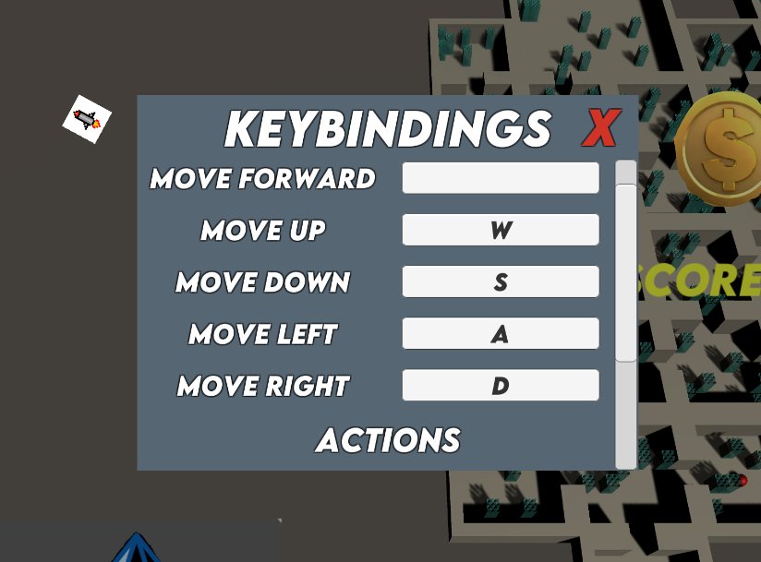
Jason - Player Specifics
Features
Rebindable Keys that save for another time
Keybindings menu automatically makes space for newly added keys
Mouse Cursor that dictates player’s rotation
Text Popups anywhere that can move and despawn over time(Current Implementation is hitting walls, enemies and standing on the exit)
Knowledge applied
Cursor : Direction and such from Vectors
Problems
Documentation of how to create a runtime keybind manager is lacking
Mouse cursor rotation cannot be done with a gameobject and must be used with some GUI item in scripting
Future Improvements
Improve the script of the mouse cursor to take into account the size of the image and automatically move to the center top of the image
Add more functionality to text popups such as changing text

Slide 9
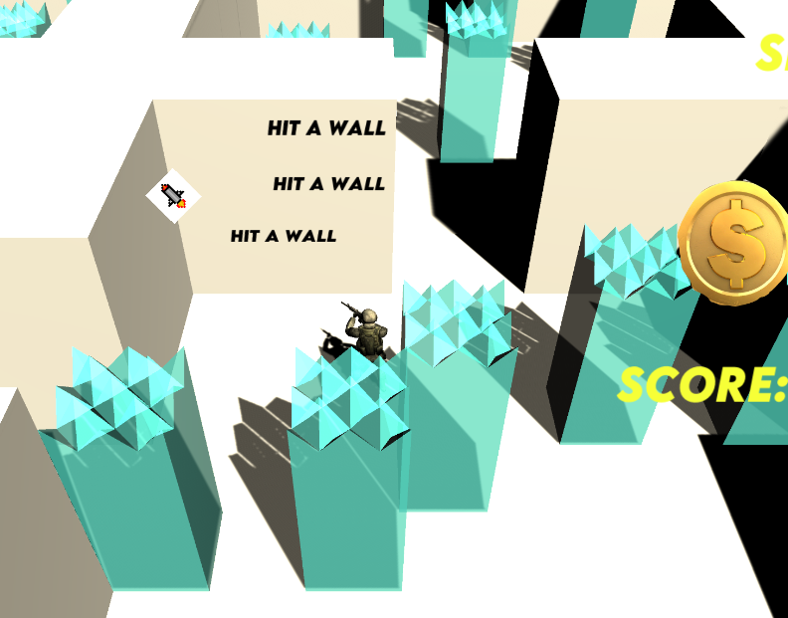
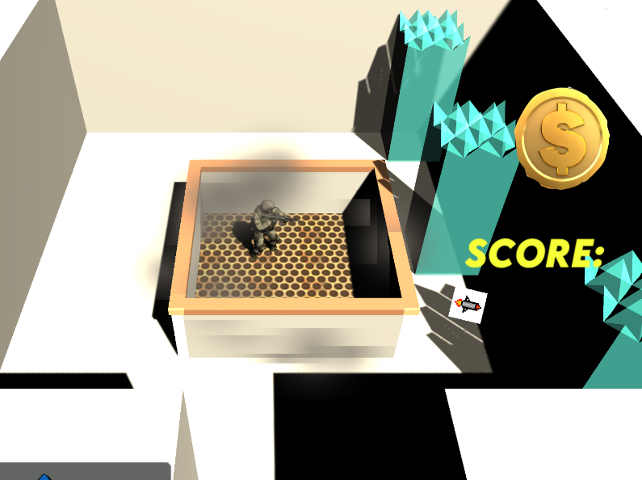
Jason - Others
Breakable Objs
Just stuff that despawn when hit
Some Maya Experience applied
Exit
Features
It’s just a animation on objects
Sends the player to the endscreen
Problems
First Time doing unity animation was difficult
Tuning for the thing to change properly was messy with the collision.
Mesh colliders not working with animations really wasted a lot of time
Trying to get particles to work with animation was a pain
Future Improvements
Spend less time on animations.

Slide 10
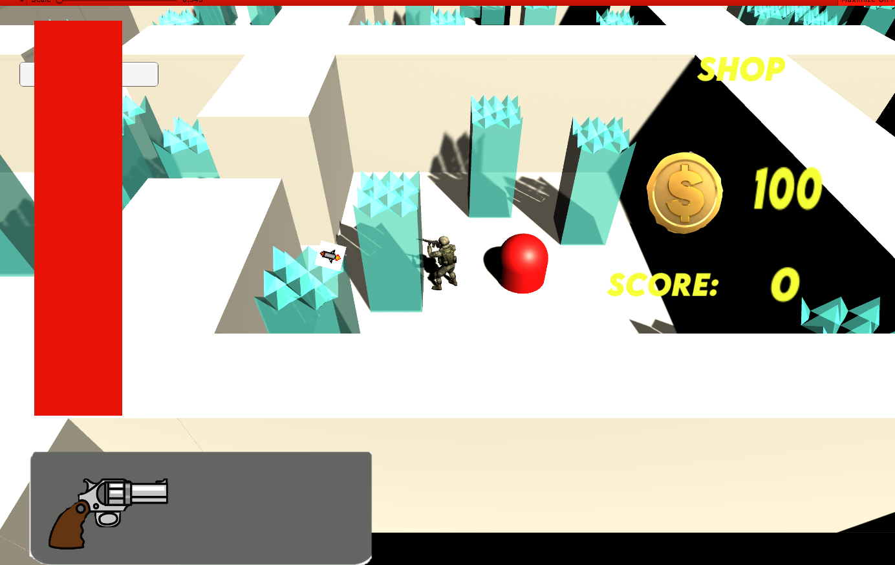
Darren
Ui:
Applied knowledge from Interface Design
Problems include lack of familiarity with Unity and was fixed by taking time to get used to Unity
Image that can be turn on and off

Slide 11
Darren
Scenes:
Switching scenes using Interface Design
Unity tools unfamiliar
Weapons:
Gun
C# different from C++ so took too much time
Can do it faster in the future

Slide 12
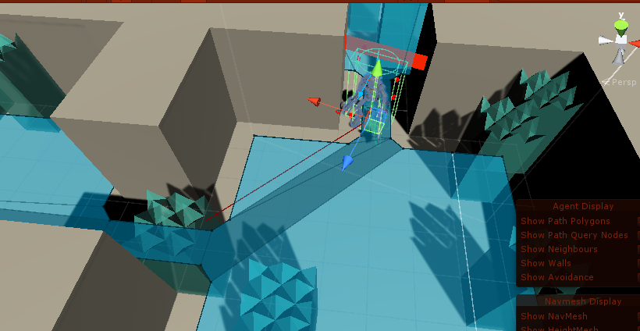
Marcus
EnemyAI
Implemented States and Statemachines that were taught in AI module
Implemented Navmesh system and waypoint system
Enemy uses Navmesh system to find a path to its destination
Destination is set in statemachines
Implemented animations for the Enemy
Chase State: chase player
Patrol State: patrol around a set of waypoints
Attack State: attack player
Dead state: die
Has healthBar UI on top of it
Problems
First time using Navmesh System
Had to figure out how to get AI to move to destination
Had to build the Navmesh surface after the level was generated

Slide 13
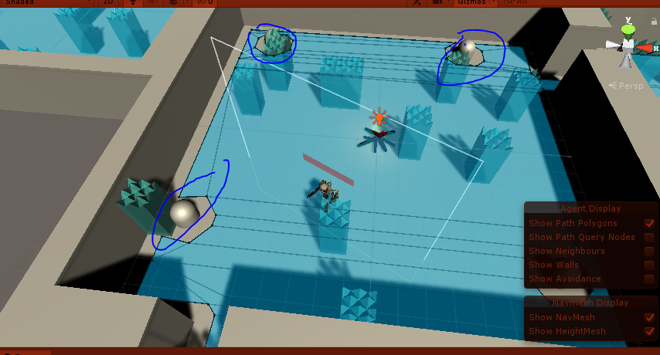
Marcus
Waypoint
Implemented waypoint system learnt from AI and AGDEV module
Each capsule on the ground represent a waypoint.
Waypoint path contains a set of waypoints
There are multiple waypoint paths around the map
Enemy will be assigned a random waypoint path and it will make its way towards it

Slide 14
Marcus
EnemySpawner
Spawns enemy off cooldown
Bonfire represent the enemySpawner

Slide 15
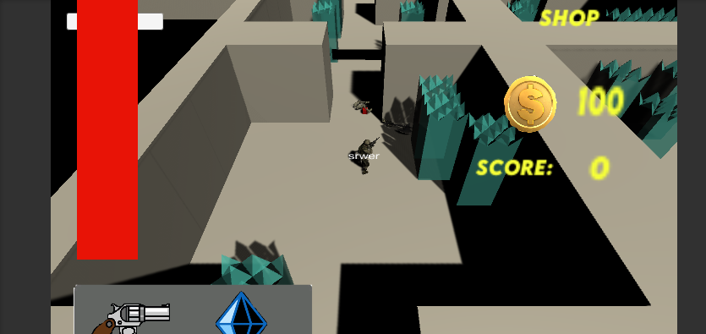
Marcus
Loot drops
Drops pickups(Red cube) for player
When player get pickup, will restore health
Implemented Player Animations
Improvements
Can add more types of pickup(For example: Pickup that changes bullet behaviour)

